Slide 1
BIN KNOWS BEST
TEAM 22CJRO
BĂRĂIAN ANDREI
OLTEAN VICTOR
SABĂU ANDREI
ADVISOR: Dr. Eng. Negru Mihai

Slide 2
CONTENTS
PROBLEM
SOLUTION
COMPONENTS
IMPLEMENTATION
DEMO

Slide 3
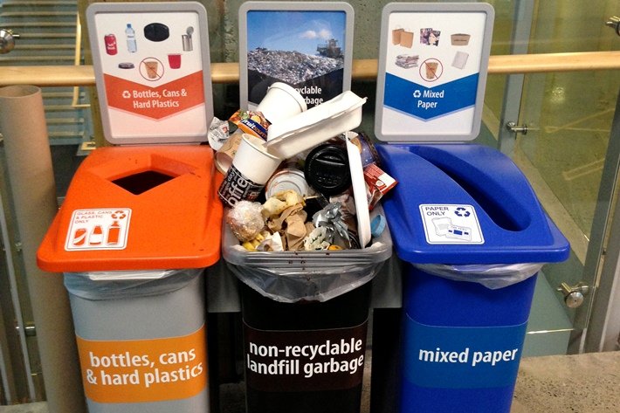
PROBLEM

Slide 4
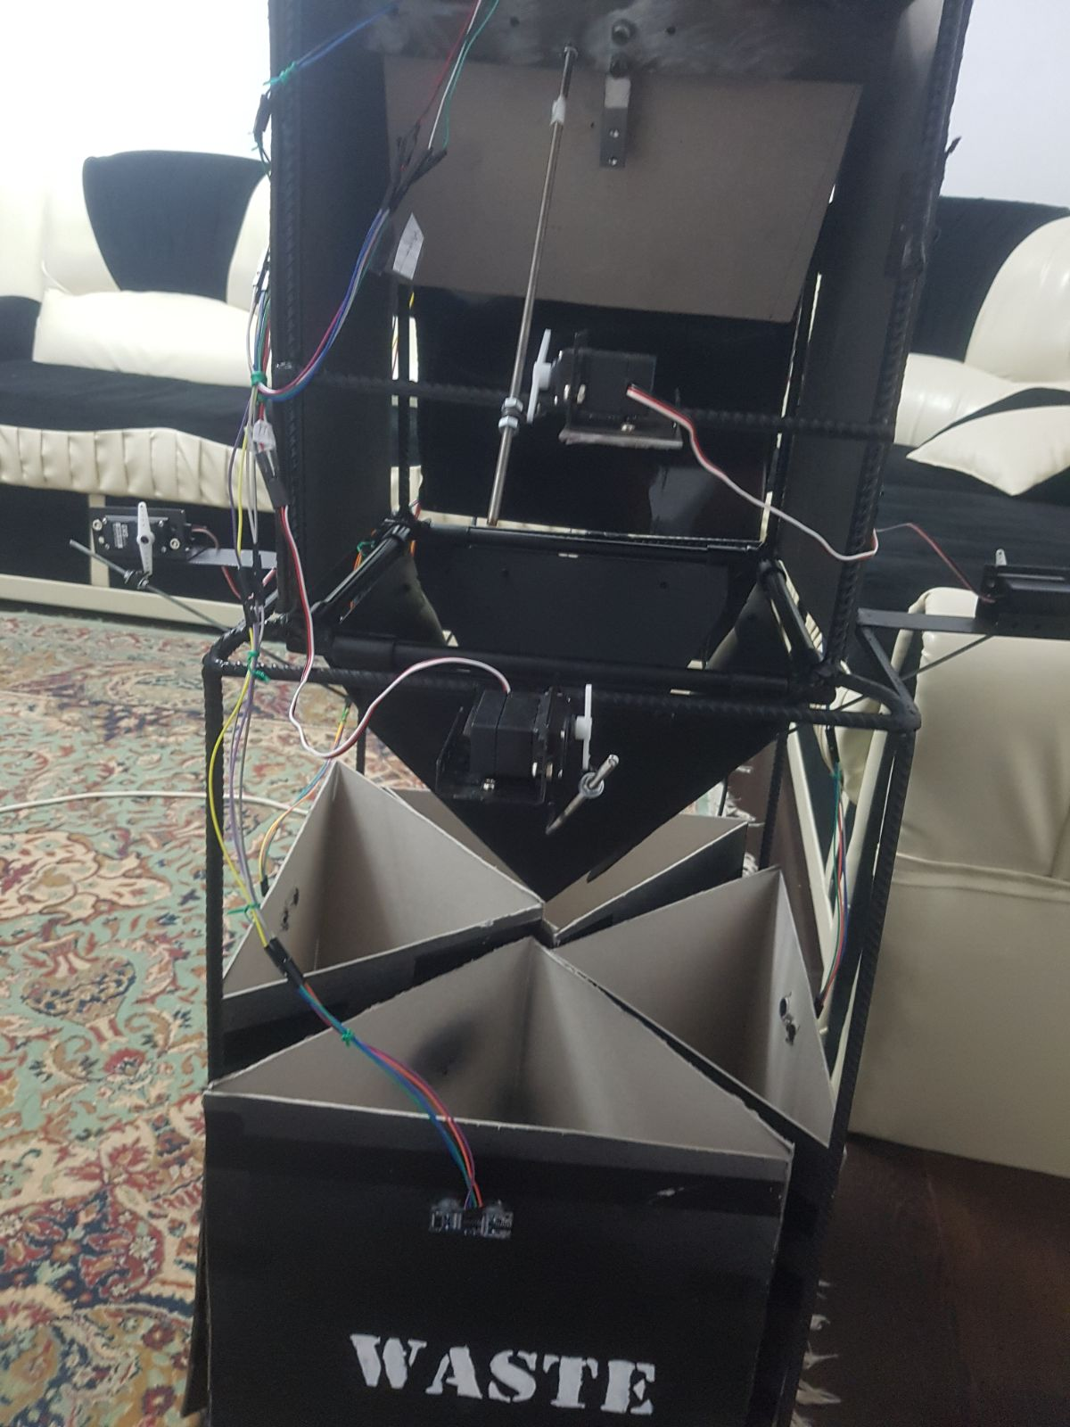
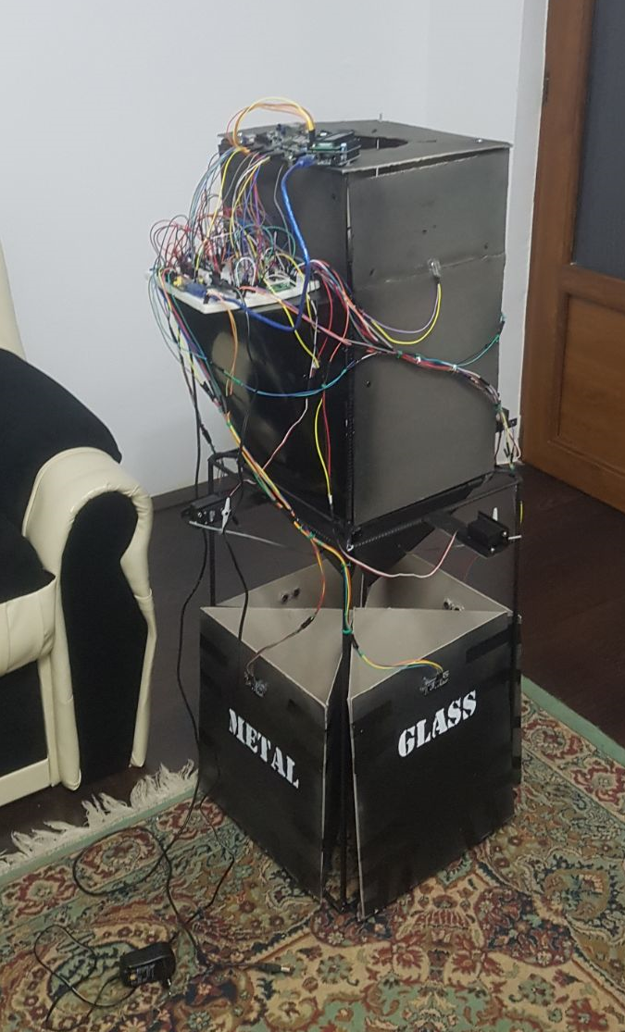
SOLUTION
PROCESSING ROOM
COMPARTMENT DOORS
COMPARTMENTS

Slide 5
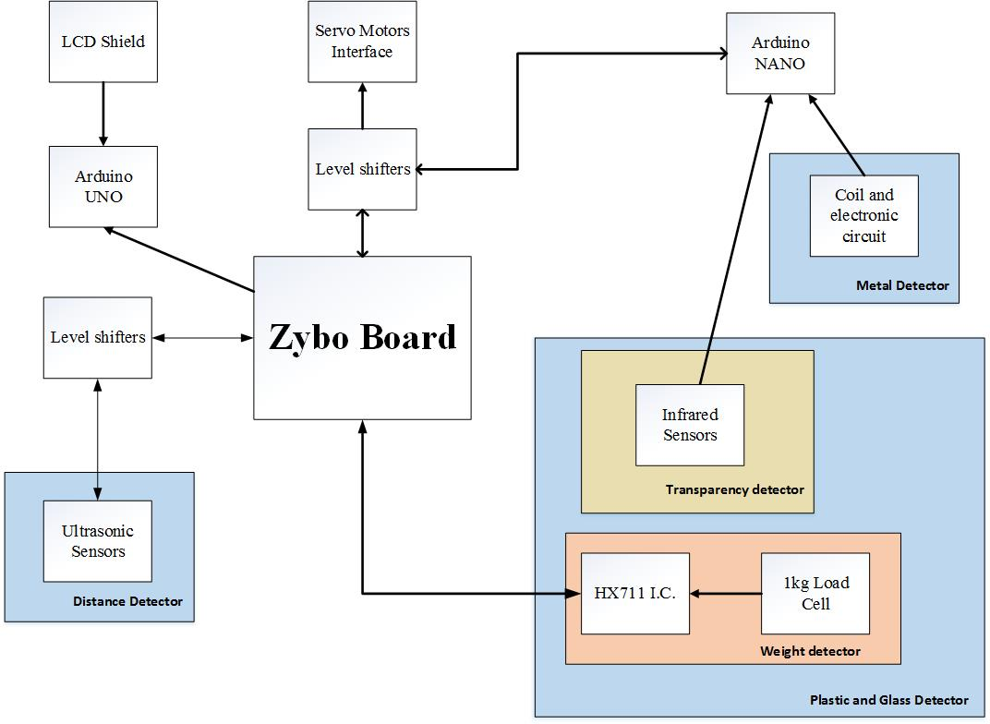
DESIGN OVERVIEW PROCESSING ROOM

Slide 6
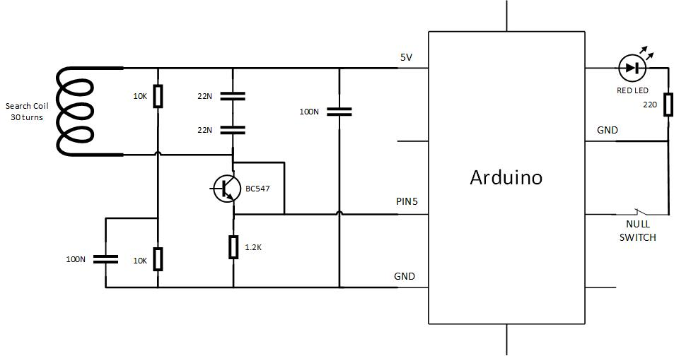
METAL DETECTOR

Slide 7
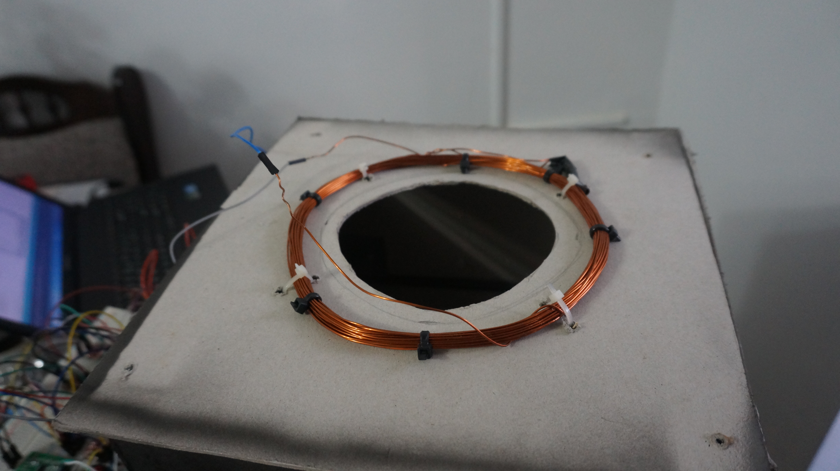
METAL DETECTOR

Slide 8
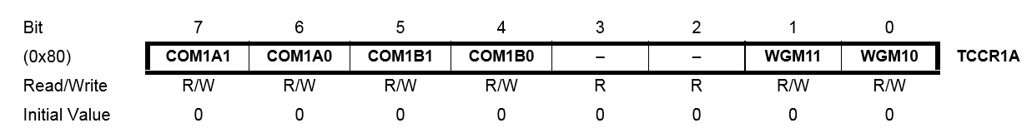
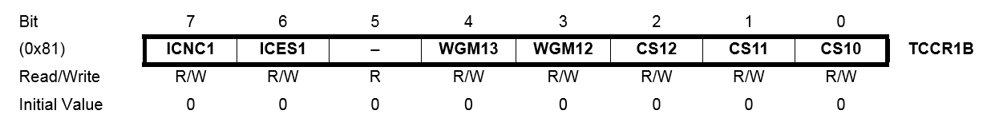
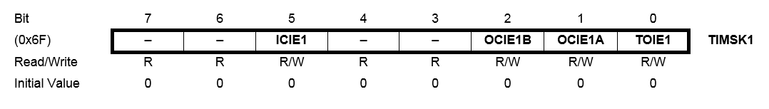
METAL DETECTOR

Slide 9
DESIGN OVERVIEW PROCESSING ROOM

Slide 10
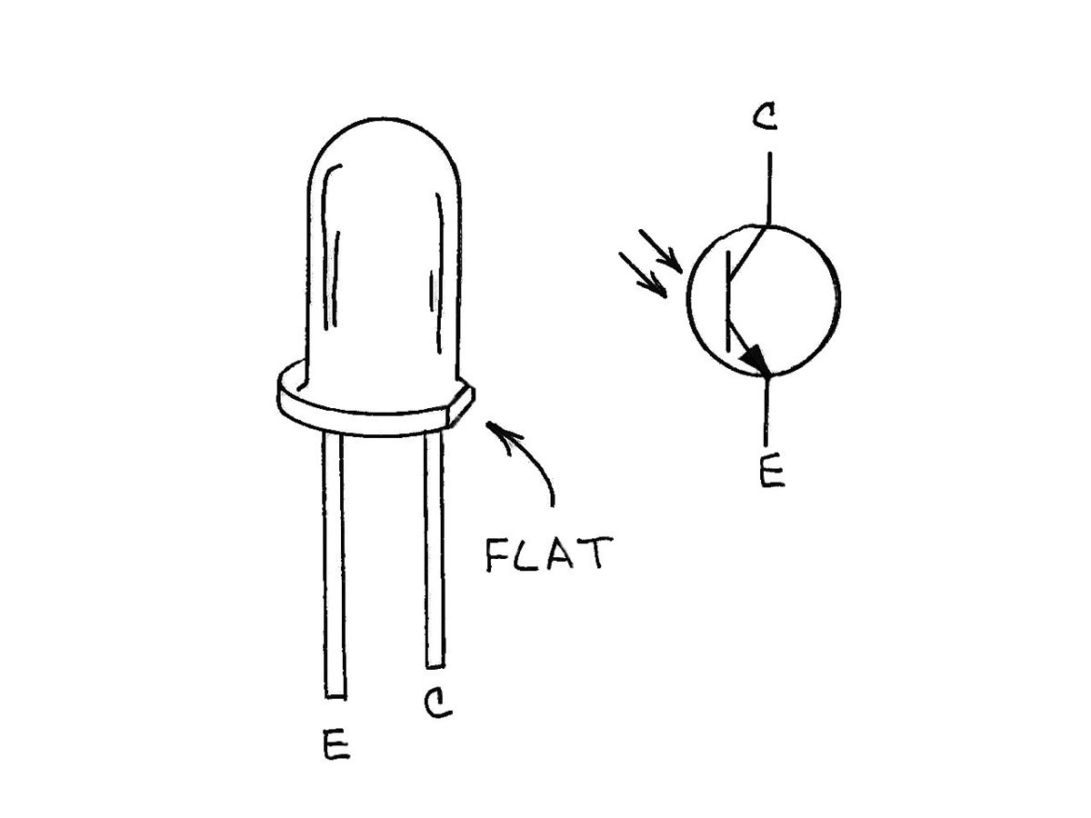
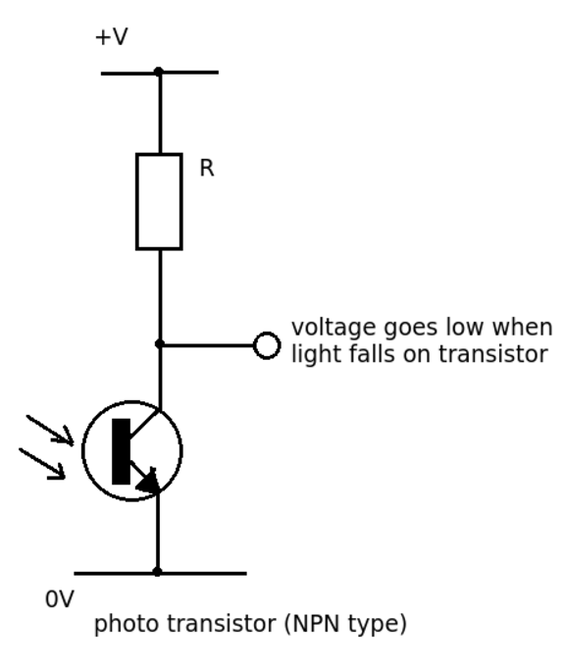
PLASTIC AND GLASS DETECTOR Transparency Detector
CIRCUIT DIAGRAM
PHOTOTRANSISTOR

Slide 11
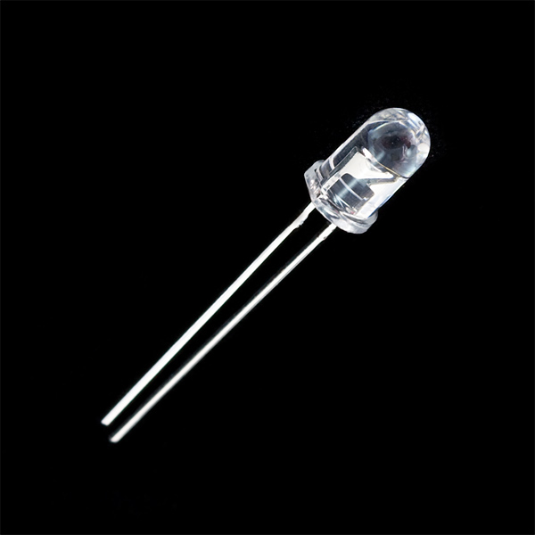
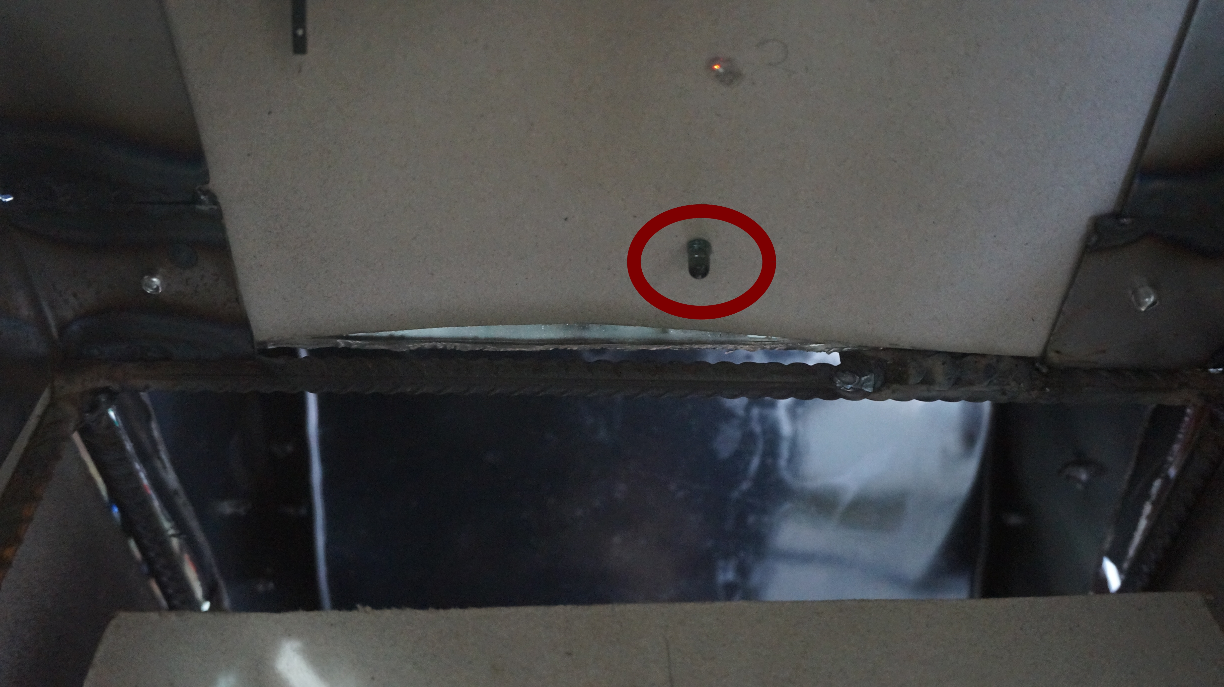
PLASTIC AND GLASS DETECTOR Transparency Detector
INFRARED EMITTER
PHOTOTRANSISTOR

Slide 12
DESIGN OVERVIEW PROCESSING ROOM

Slide 13
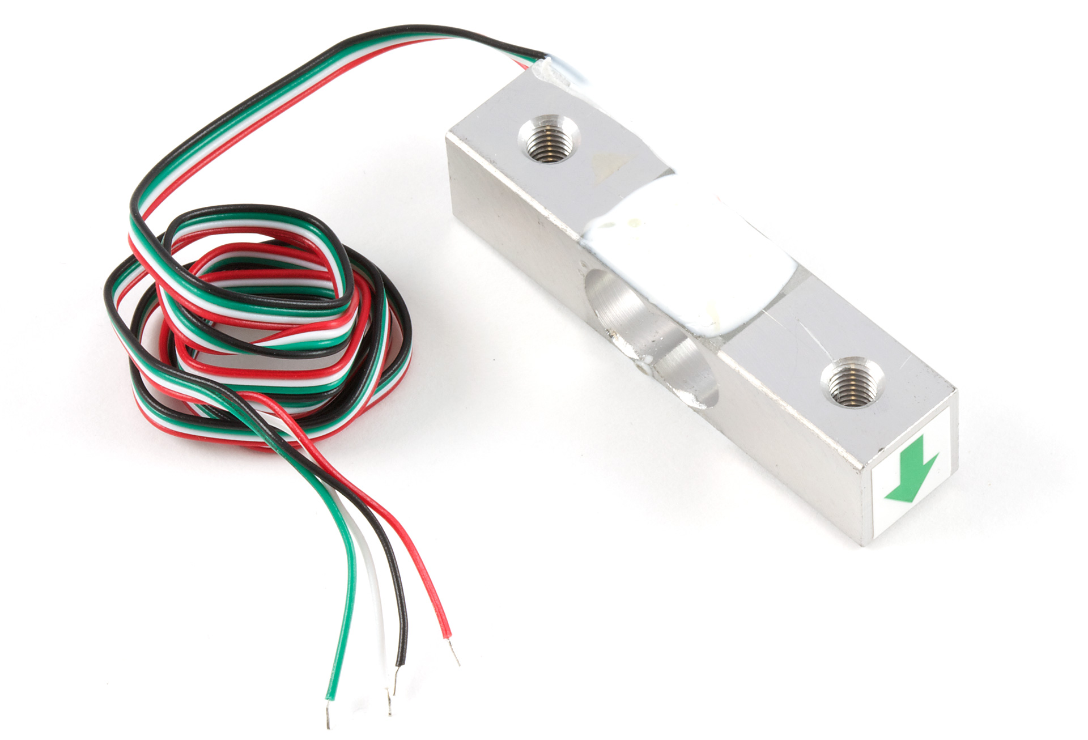
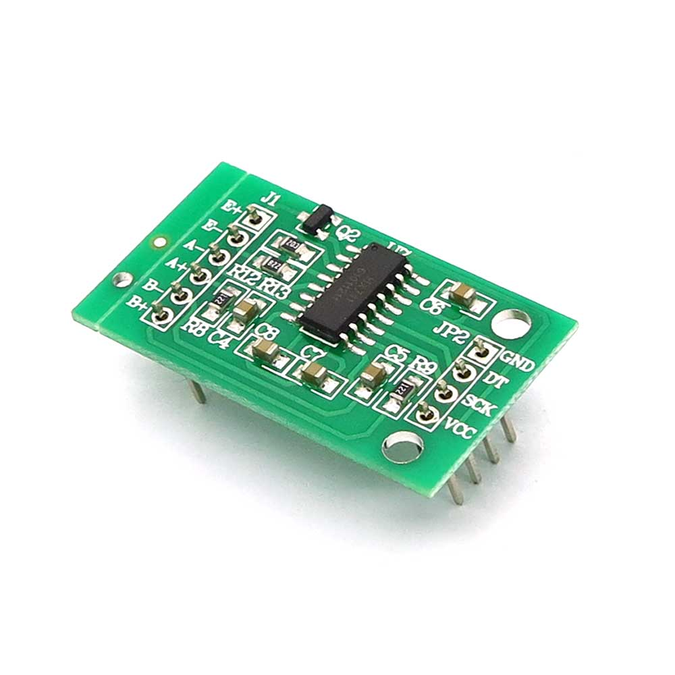
PLASTIC AND GLASS DETECTOR Weight Detector
ONE KG LOAD CELL
HX711

Slide 14
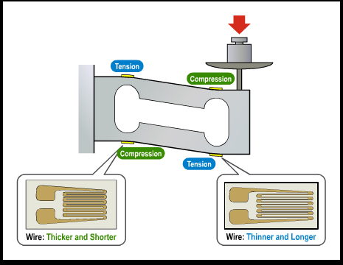
PLASTIC AND GLASS DETECTOR Weight Detector

Slide 15
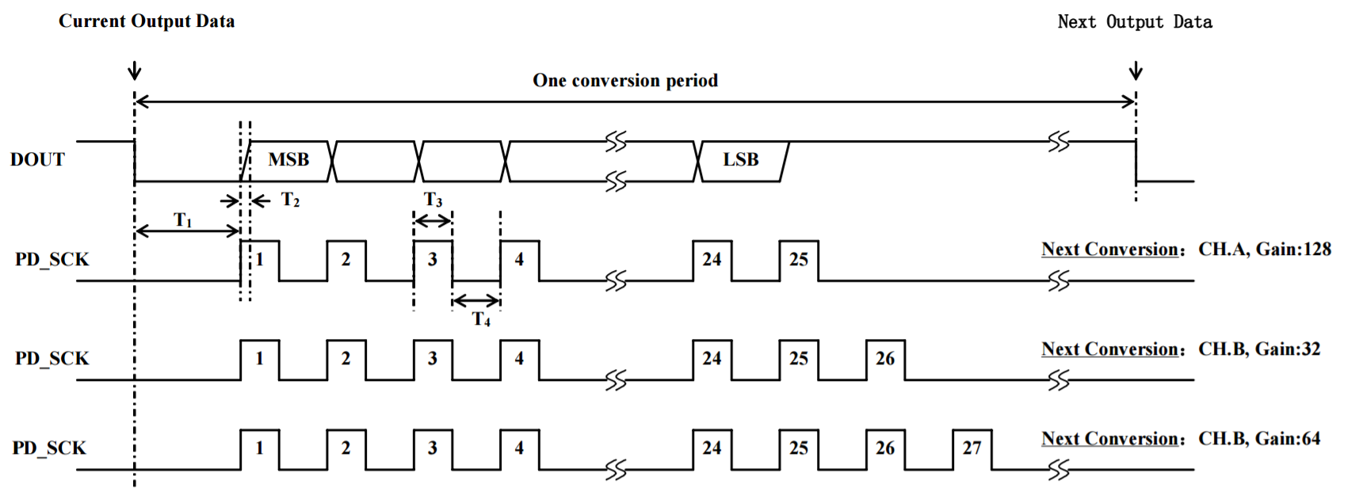
PLASTIC AND GLASS DETECTOR Weight Detector

Slide 17
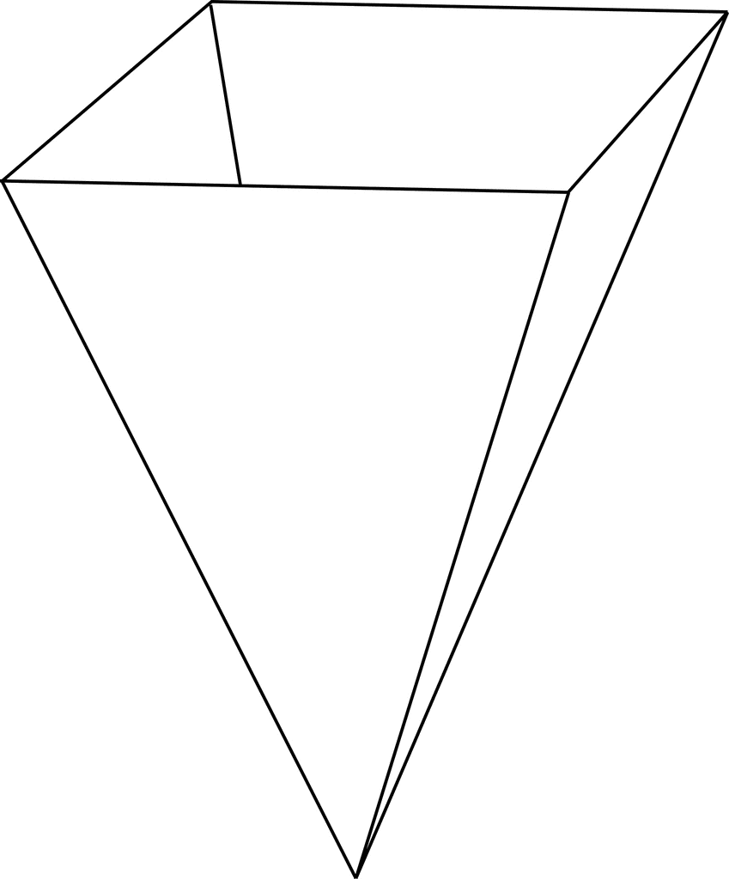
PHYSICAL DESIGN

Slide 18
DESIGN OVERVIEW PROCESSING ROOM

Slide 19
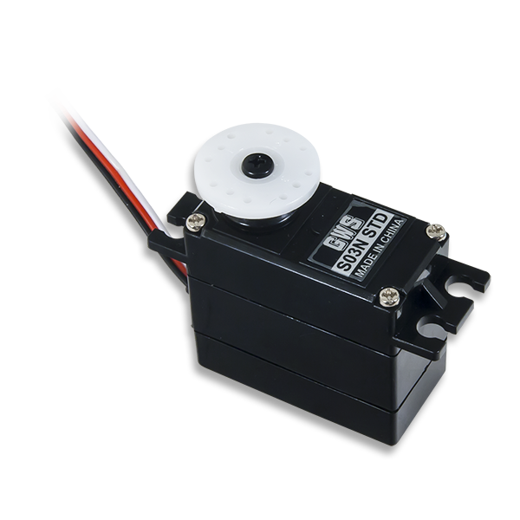
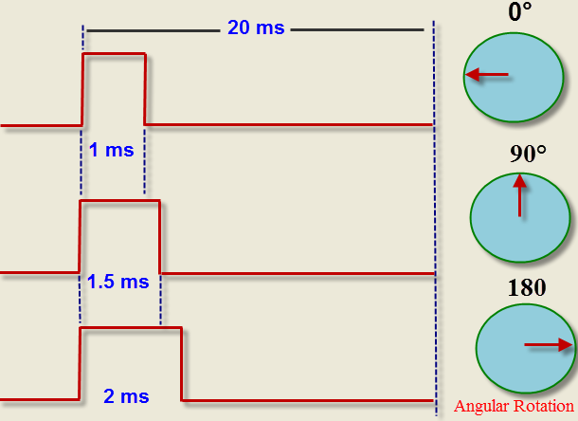
SERVO MOTOR

Slide 20
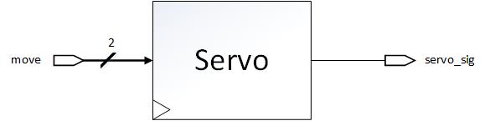
SERVO MOTOR
Name | Width | Direction | Description
CLK | 1 | Input | 125MHz provided by the ZYBO board
move | 2 | Input | signal controlling how a servo should move
servo_sig | 1 | Output | PWM signal controlling the servo
The ‘move’ signal can be:
“00” or “11” - the servo does nothing
“10” - the servo will move to 180°
“01” - the servo will move to 0°

Slide 21
SERVO CONTROL

Slide 22
DESIGN OVERVIEW PROCESSING ROOM

Slide 23
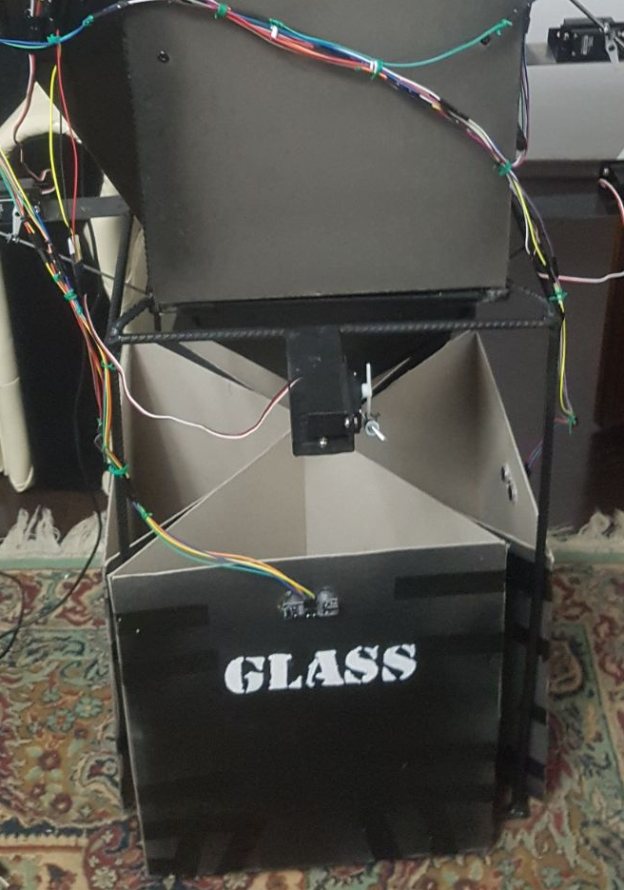
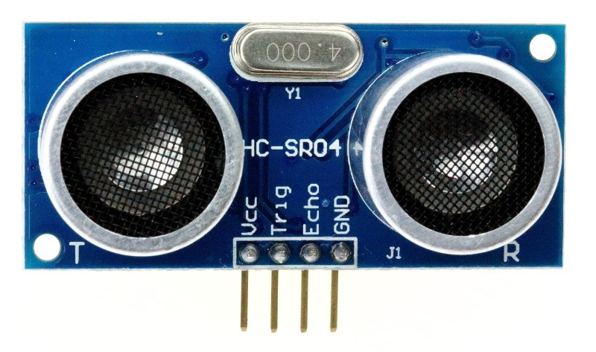
DISTANCE DETECTOR

Slide 24
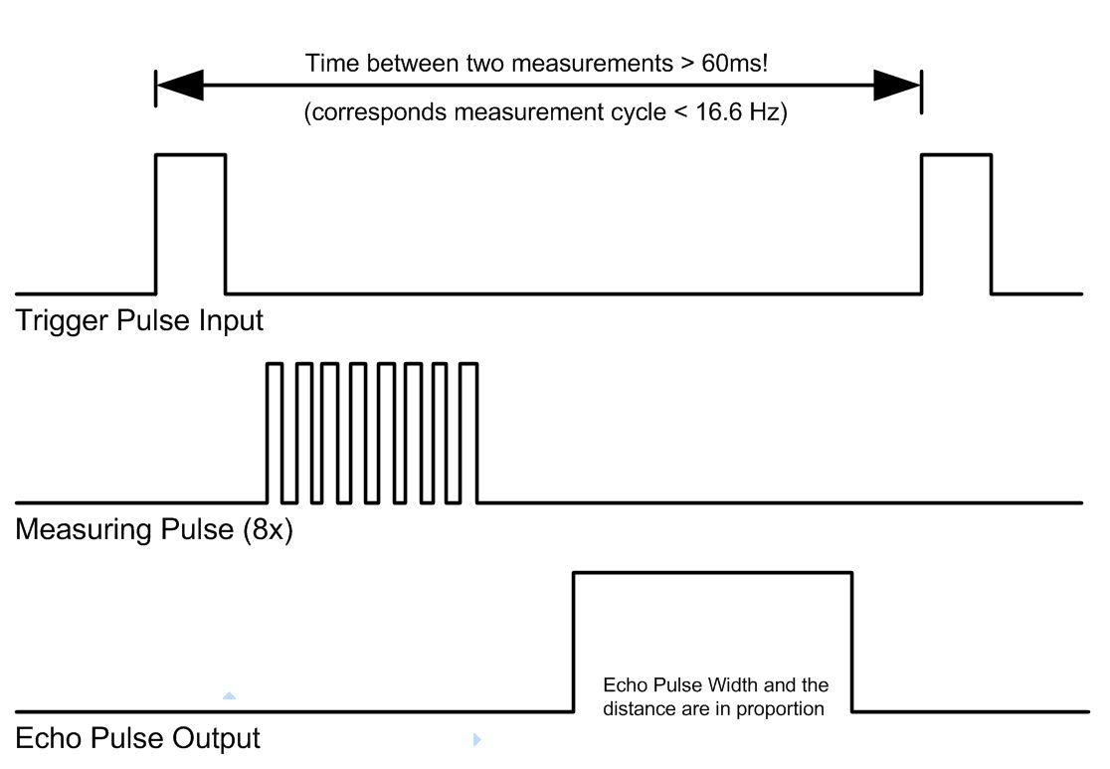
HC-SR04 Timing Diagram

Slide 25
DESIGN OVERVIEW PROCESSING ROOM

Slide 26
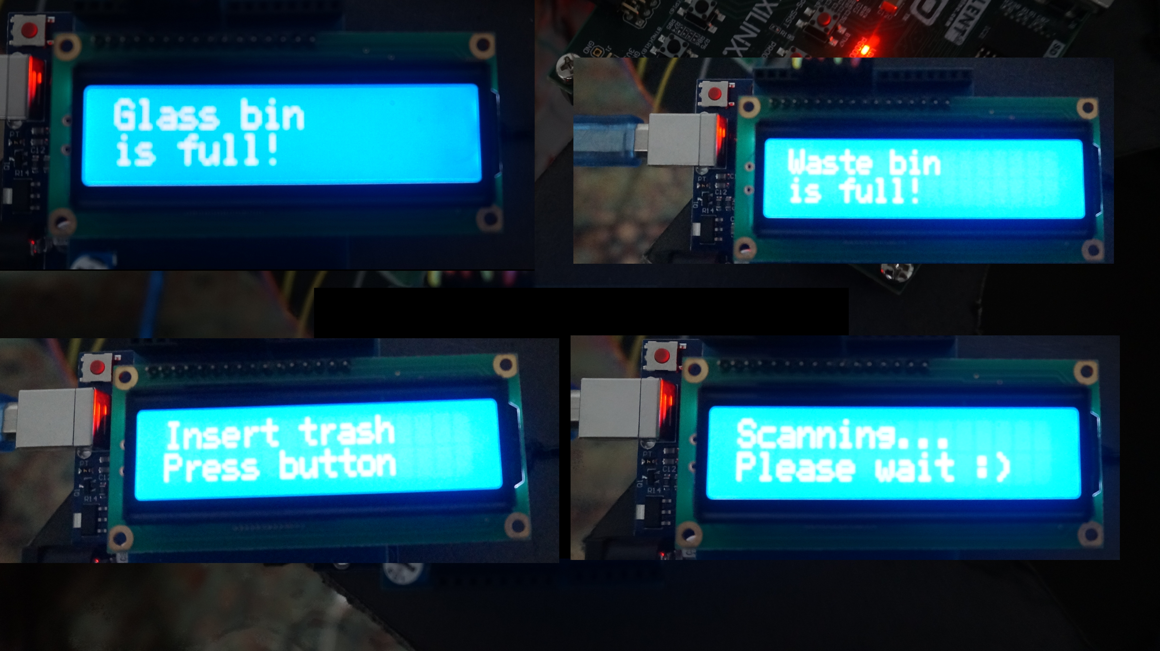
LCD SHIELD

Slide 27
FSM

Slide 28
DEMO TIME

Slide 29
QUESTIONS?

Slide 30
THANK YOU FOR YOUR ATTENTION!

